Slide 1
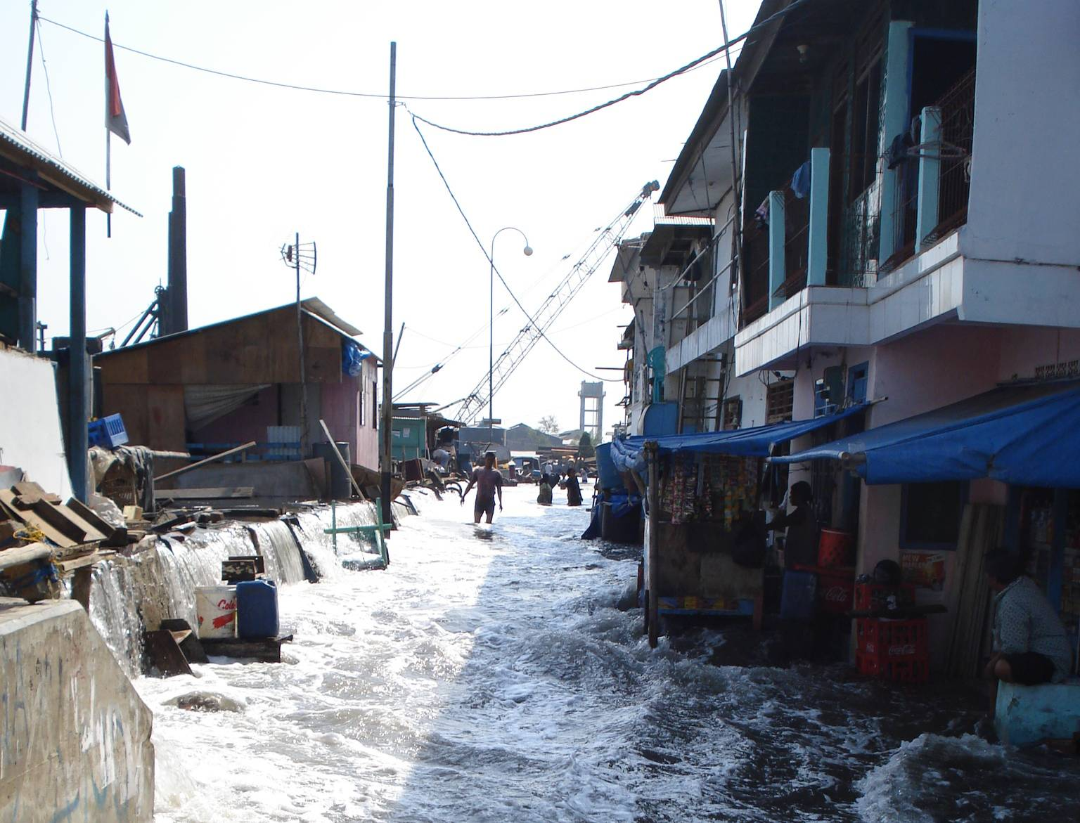
Banjir dan Rob - de strijd tegen overstromingen – hoe Indonesie langzaam wegzakt onder de zee
Herman Mondeel

Slide 2
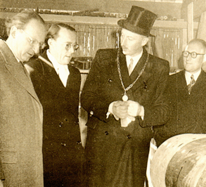
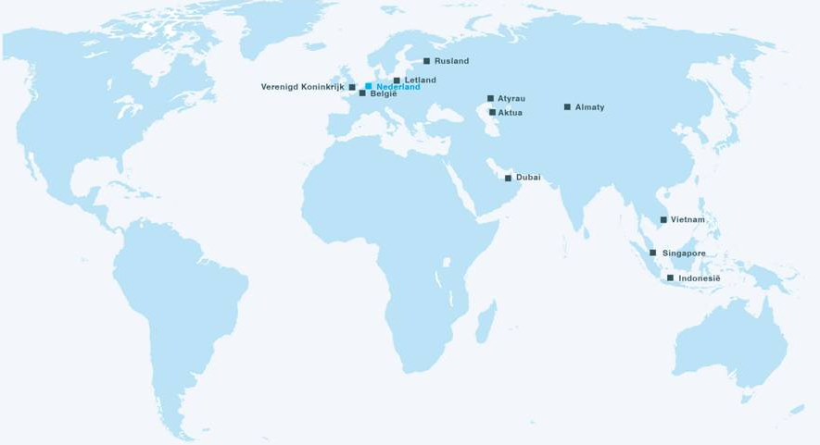





Witteveen en Bos 1946
  Bos (37): civil engineer (Enschede)
  Witteveen (54): Director Public Works (Rotterdam)
  1,100 employees
  Working Globally
  Aim to contribute to SDG’s
  Office in Jakarta since 1978

Slide 3
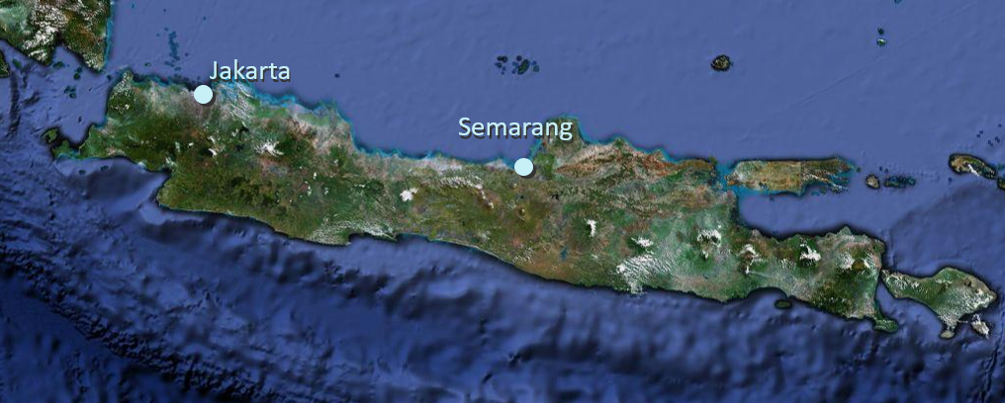
Land subsidence and flooding
Jakarta
Semarang
Demak (near Semarang)
Notes:
Demak

Slide 4
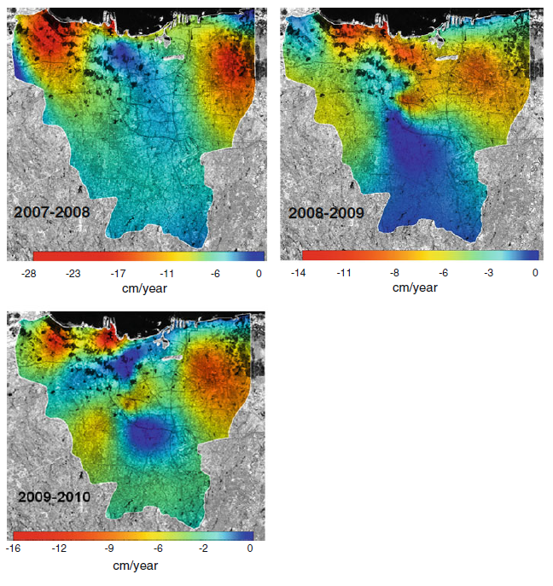
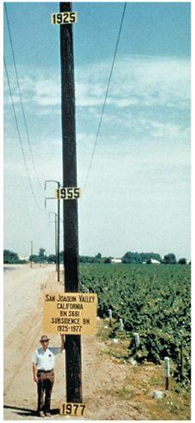
Land subsidence and sea level rise
Notes:
Land subsidence in 30 years up to more than 3 m
Vroeger ook al overstroming

Slide 5
Notes:
5 to 9 cm /year

Slide 6
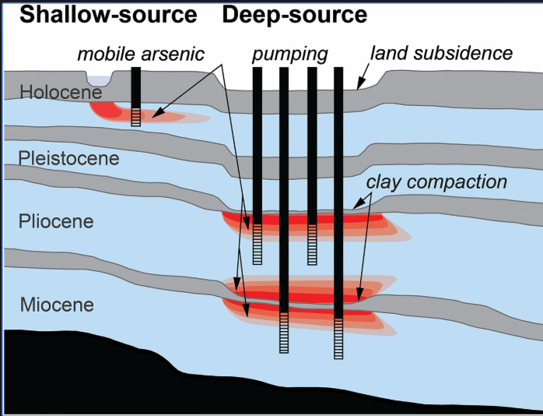
Cause of land subsidence

Slide 7
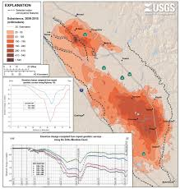
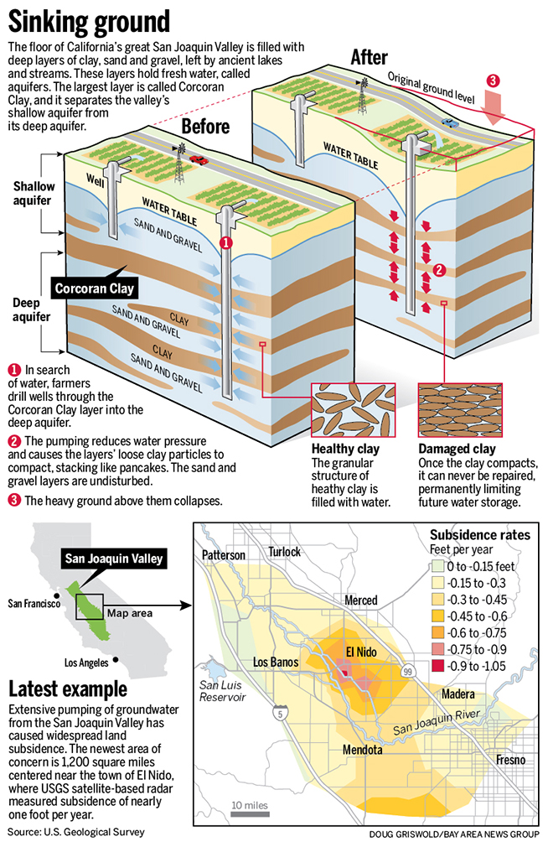
California

Slide 8
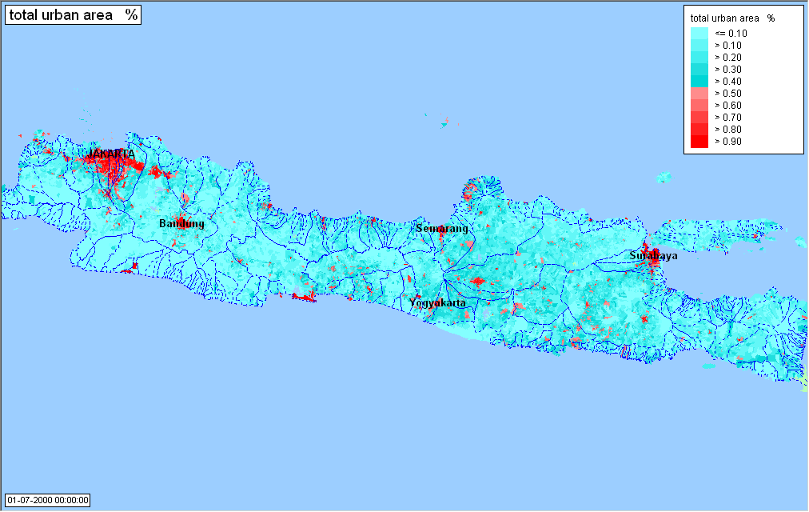
Urbanisation
Notes:
Populaiton Jakarta
Semarang

Slide 9
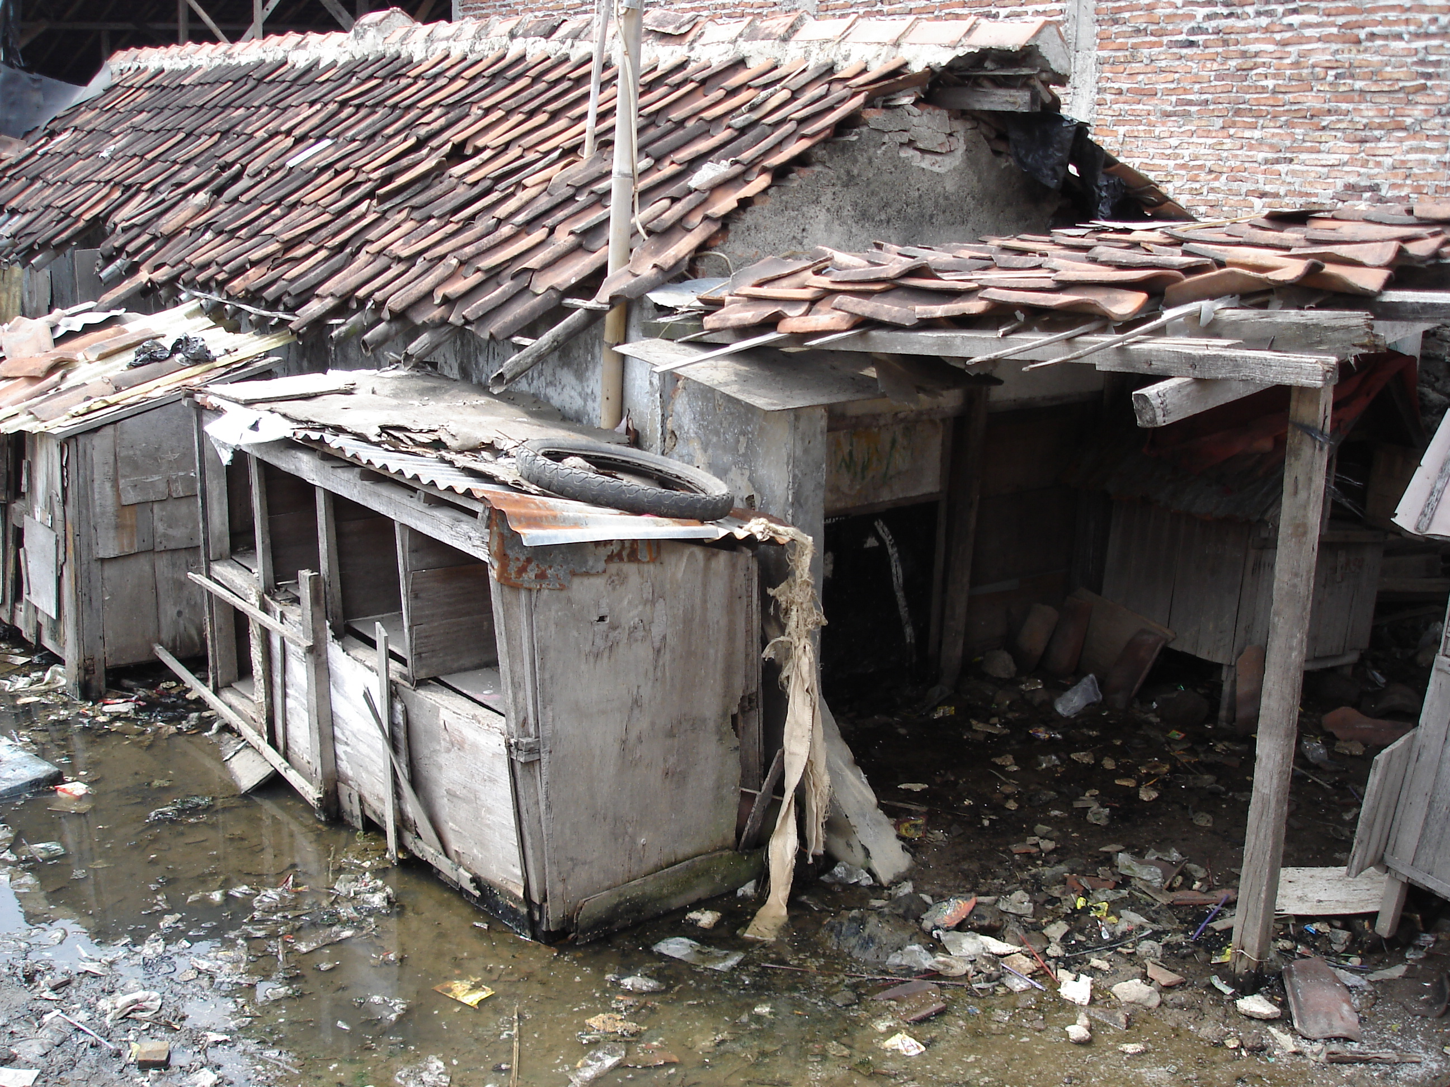
5 March 2009
9

Slide 10
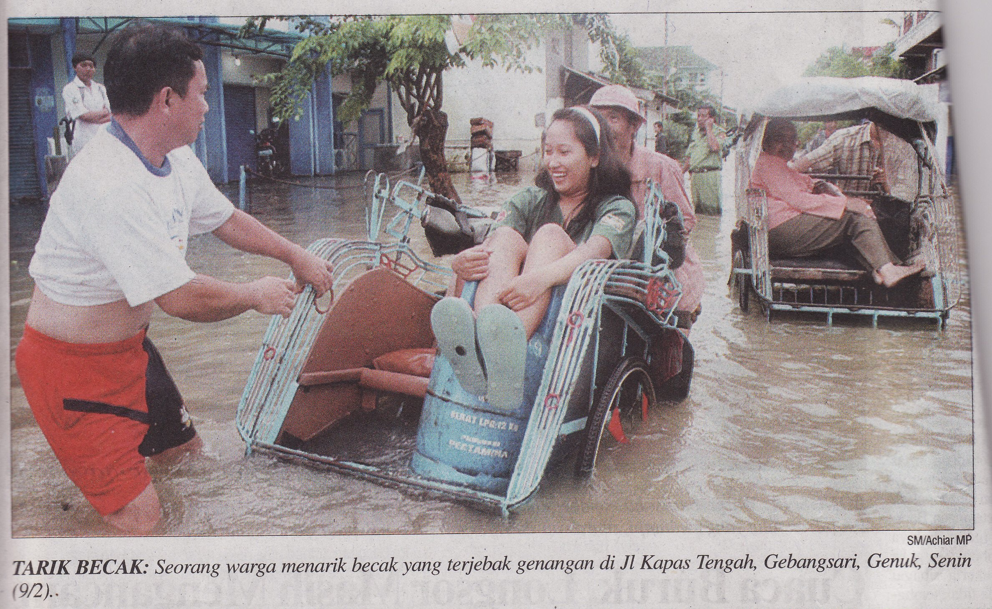
Rainfall (Banjir)
once per year 100 mm in one day
once per 100 years: 200 mm
Notes:
T1 valt bij ons eens per 100 jaar
T100 ongeveer 100 mm

Slide 11
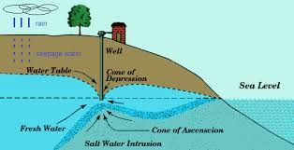
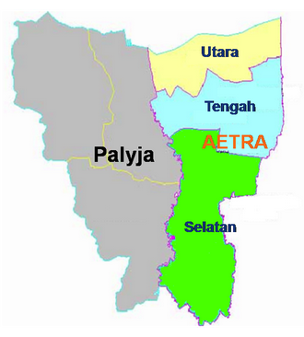
Water supply and groundwater extraction
- Source potable water:
    Water supply companies 60%;
    Others: 40%;
- Non revenu water: 40%
- No 24/7delivery

Slide 12
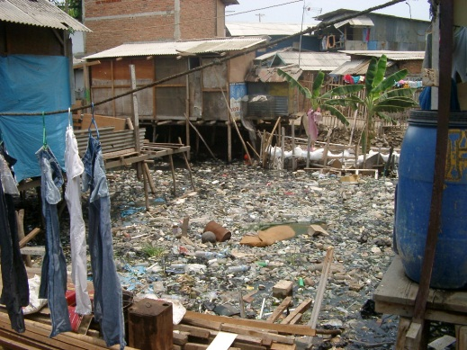
Solid waste and water quality

Slide 13
















National Capital Integrated Coastal Development

Slide 14
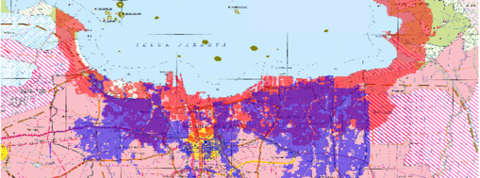
National Capital Integrated Coastal Development
Flooding from sea
(Red Zone)
Flooding from sea
(Red Zone)
Flooding from rivers
(Blue Zone)
Flooding from rivers
(Blue Zone)

Slide 15
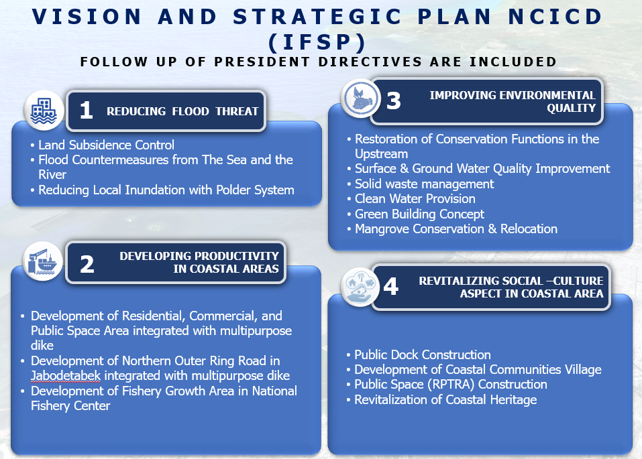

Slide 16
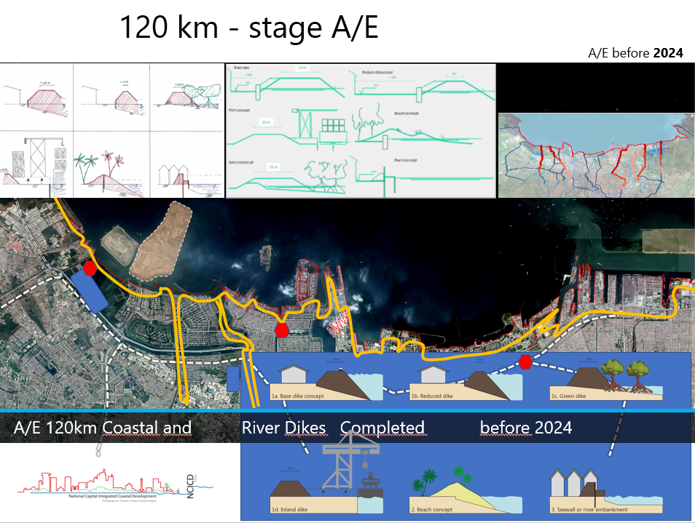

Slide 17
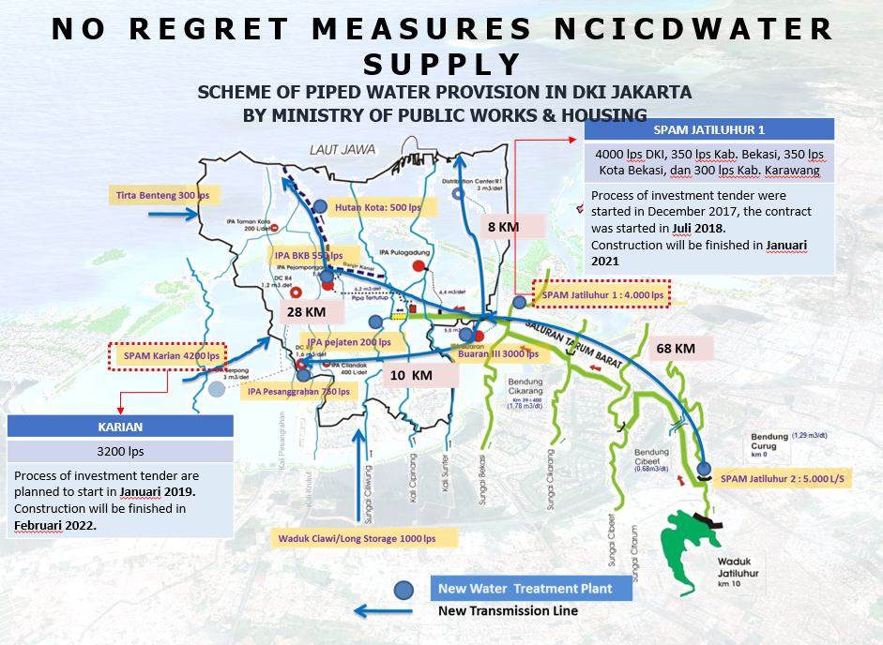

Slide 18
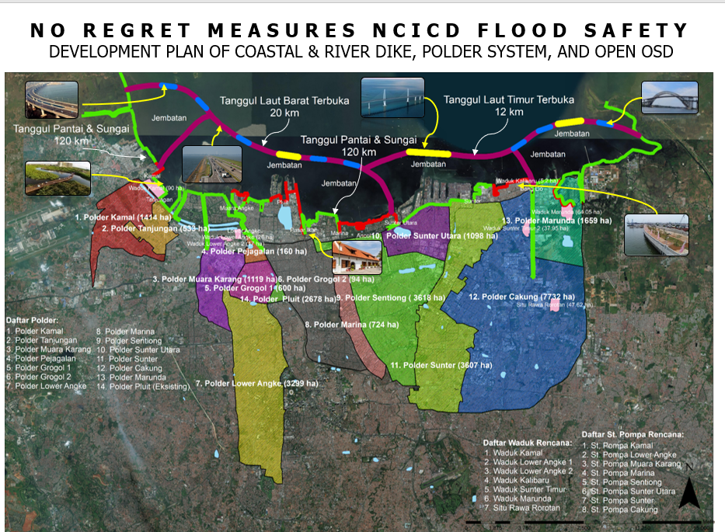

Slide 19
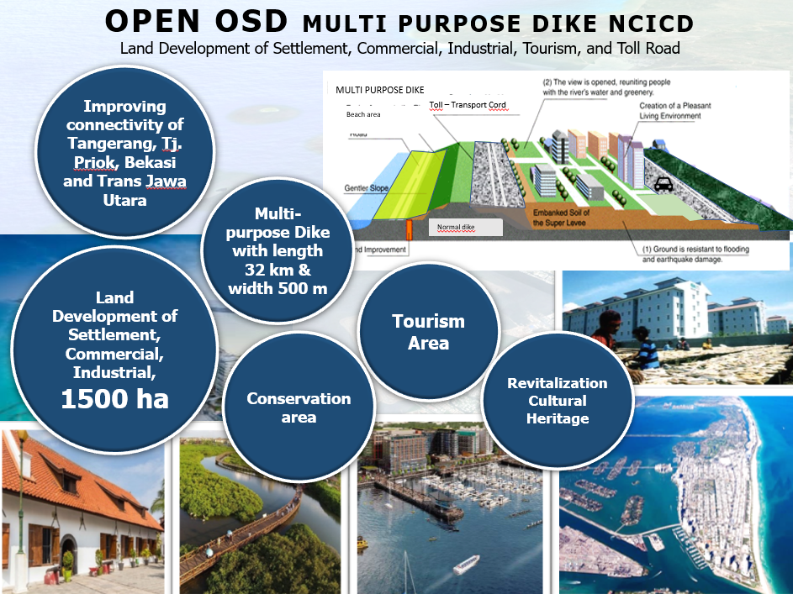

Slide 20
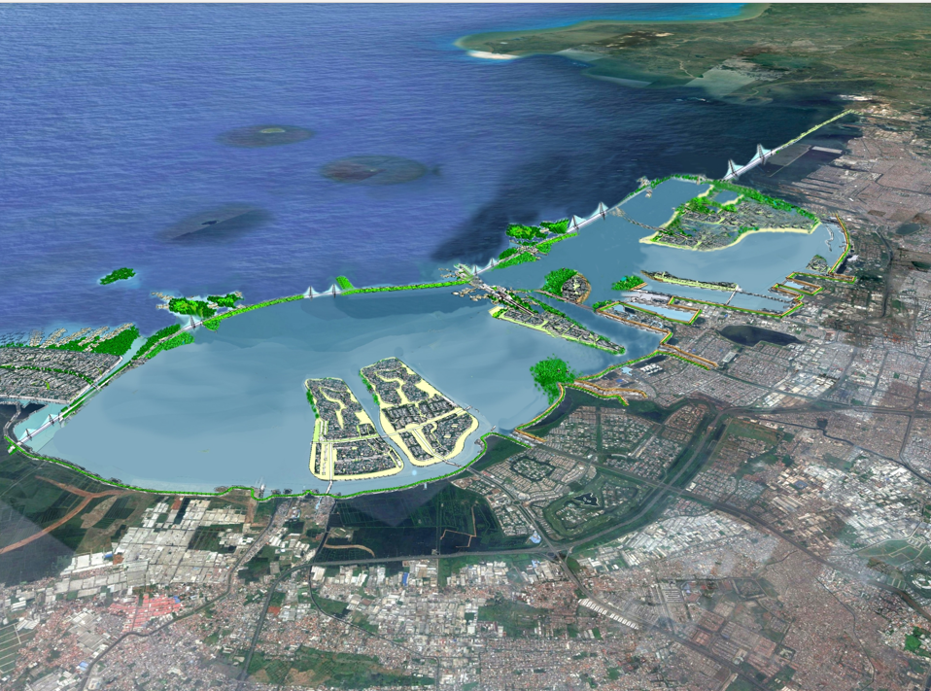
Imagine

Slide 21
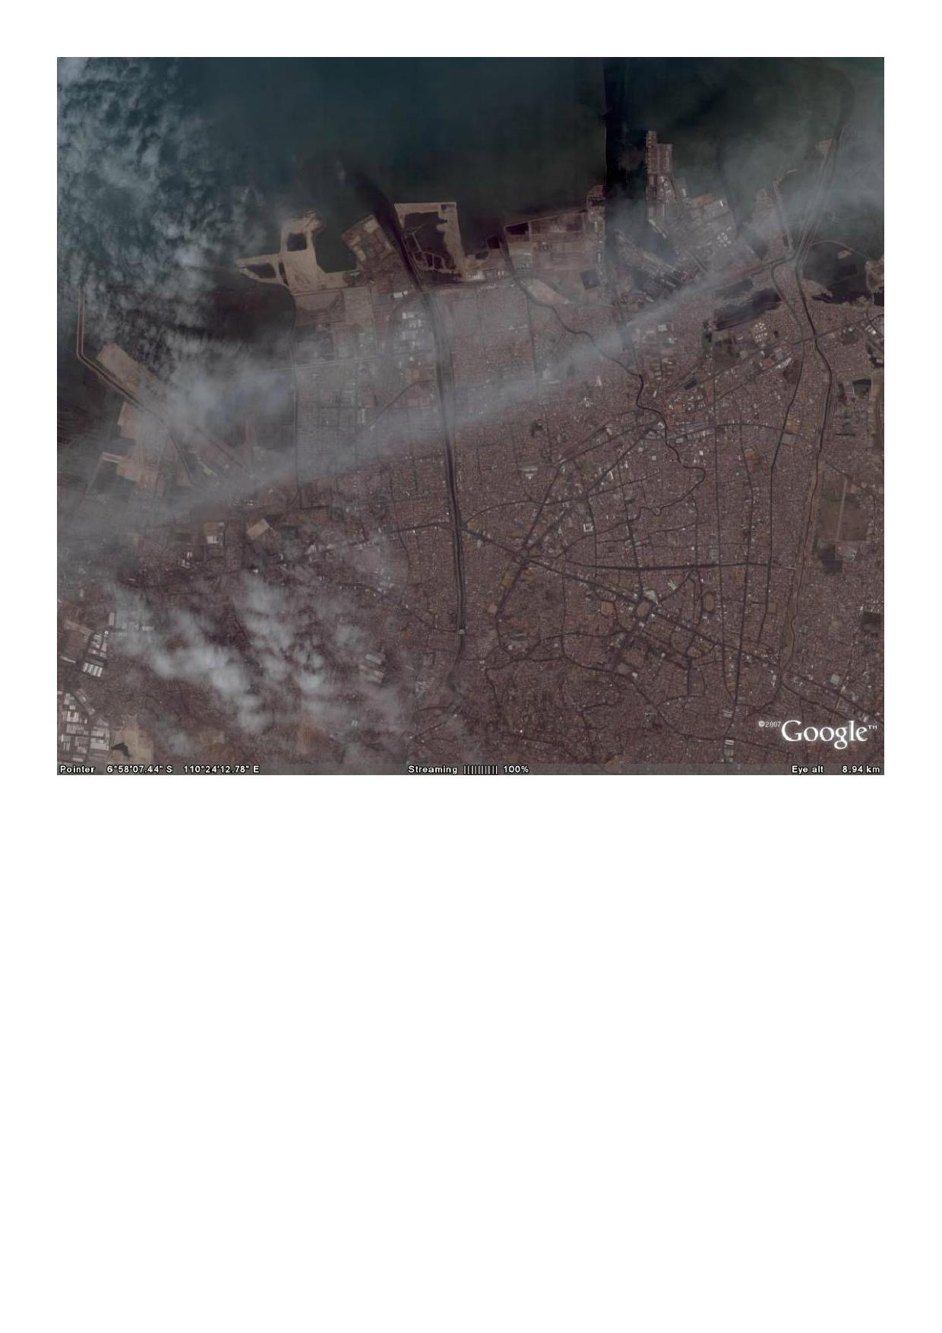
Banger polder Semarang
Banger Area
City of Semarang

Slide 22
RTL nieuws

Slide 23
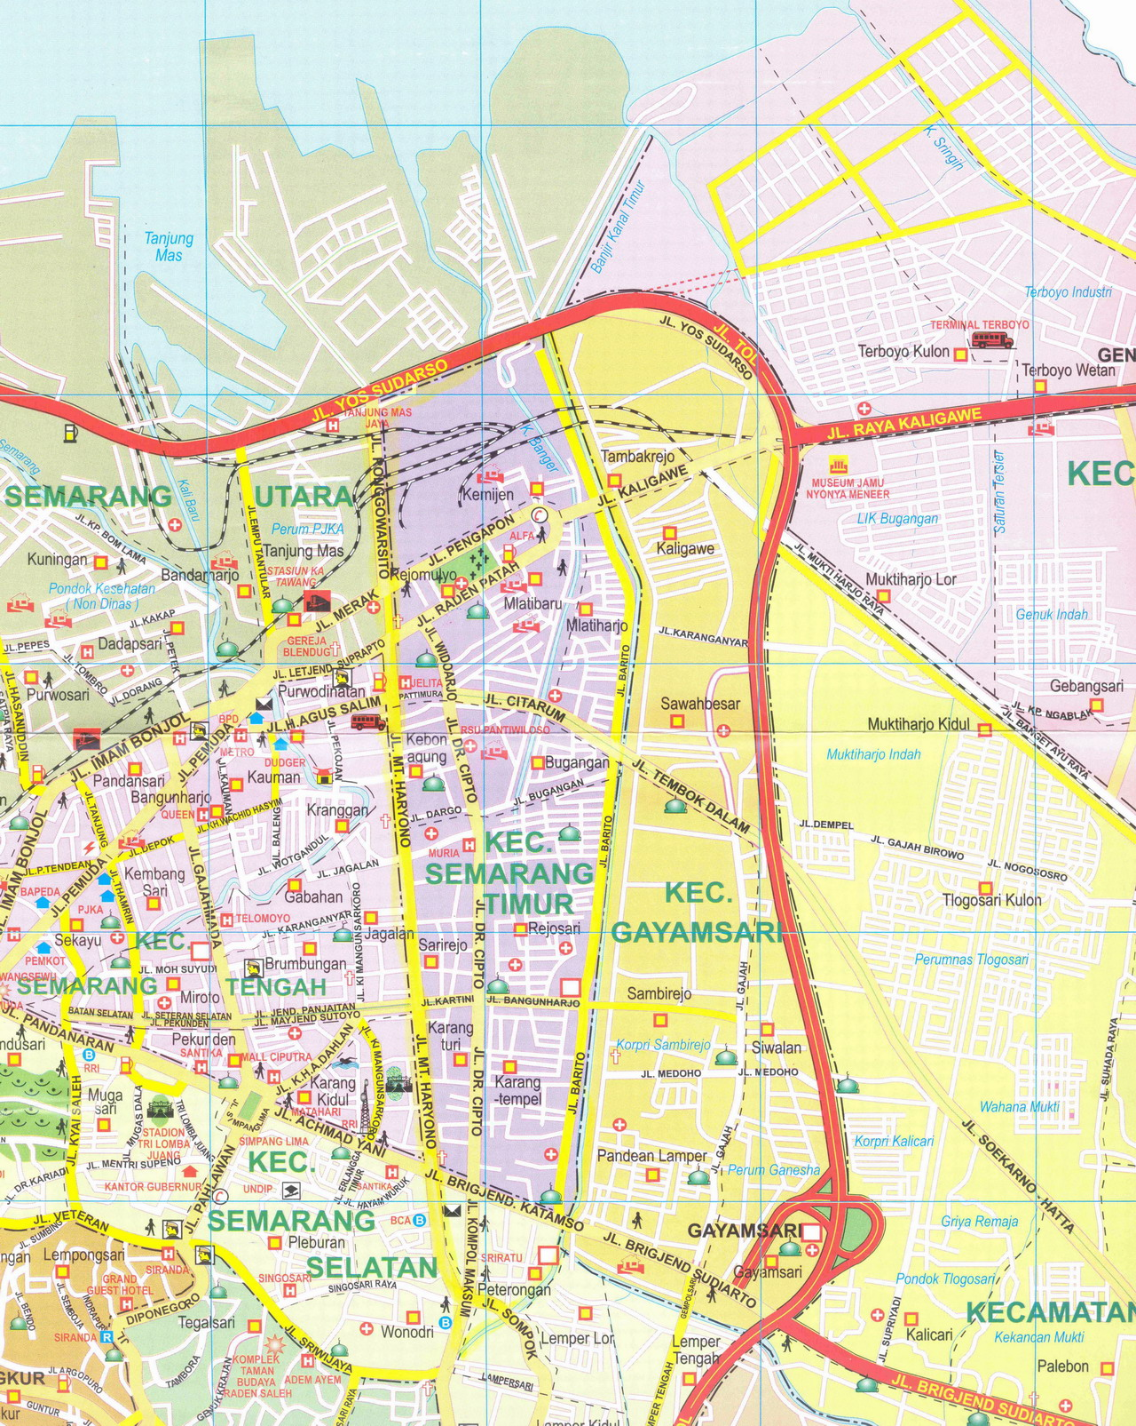
Polder Semarang
Subdistrict East Semarang
  530 ha
  85,000 inhabitants
Income:
  48% below poverty line;
  40 % vulnerable to poverty
Main infrastructure:
  railways;
  main road to harbour;
  highway Jakarta-Surabaya;
  harbour.
_{Kali Banger}
_{Banjir Kanal Timur}

Slide 24
Problem

Slide 25
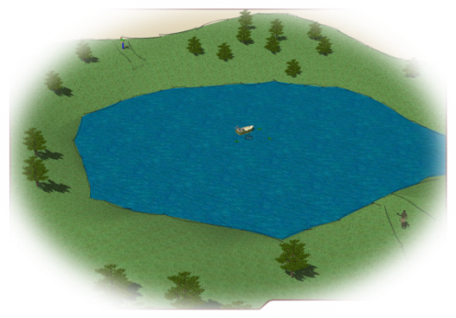
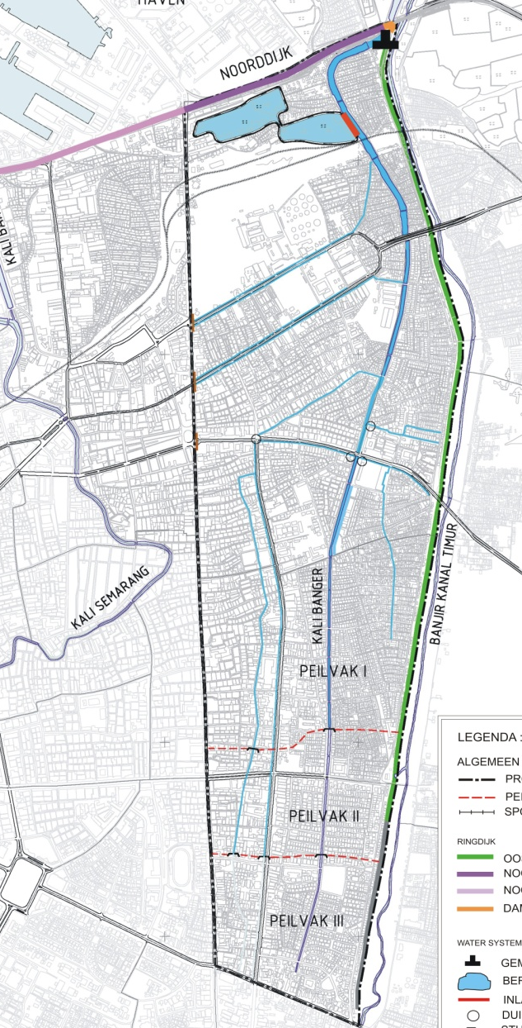
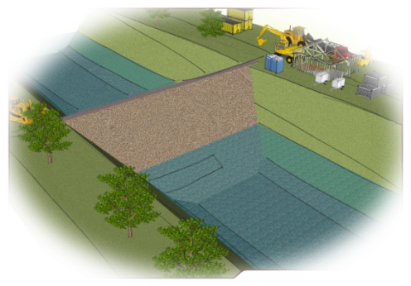
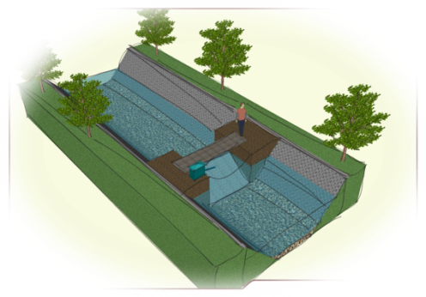
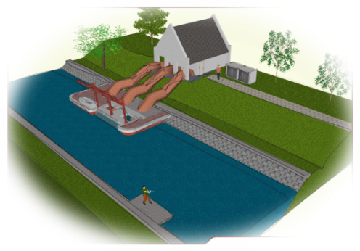
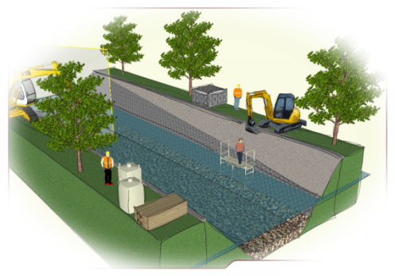
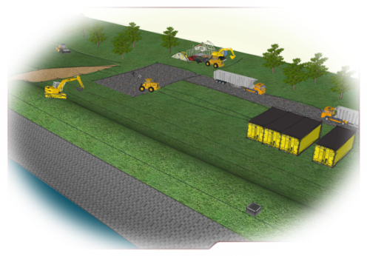
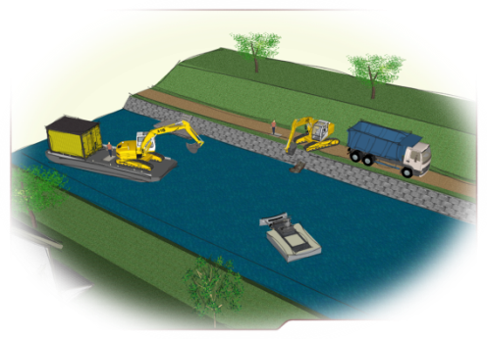
Banger Polder Semarang
retention basin
dam
weirs
pumping station
secondary drainage
improvement dikes
excavation Kali Banger
Notes:
Construction Cost 7.5 million

Slide 26
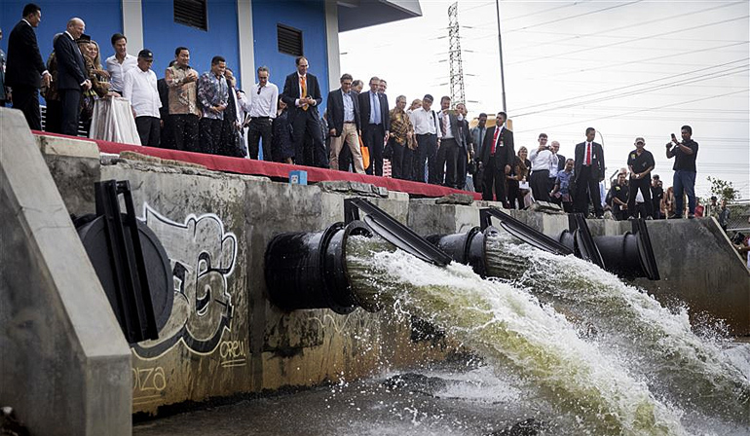

Slide 27
Stakeholders
Puslitbang
Air
VNG
International
universiteit
van
Semarang
begunstigde
kennis
KAI
adviseur
Witteveen+Bos
Partners
voor
Water
provincie
Midden-Java
UNESCO-IHE
Bina
Marga
technisch
& facilitator
mede-financier
uitvoering
Gemeente
Semarang
kennisoverdracht
Nederlandse
Waterschaps-
Bank
begunstigde
Balai
Besar
stakeholders
Banger
gebied
HHSK
begunstigde
Aqua
for
All
institutioneel

Slide 28

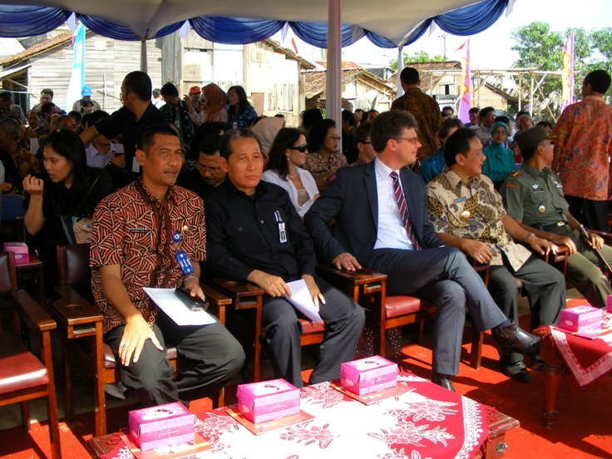
Bandan Pengelola Polder Banger SIMA (BPP SIMA)
  1st Indonesian waterboard
  Established april 2010
  Based on mayor act

Slide 29
Mangrove Restoration

Slide 30
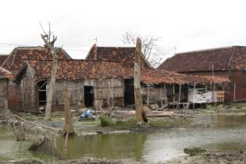

Existing situation
Paddy fields
aquaculture
Reduction mangrove
Erosion
Groundwater extraction and land subsidence

Slide 31
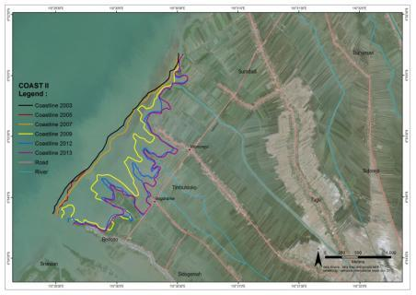
Coastal Erosion
  3 km in 10 years

Slide 32
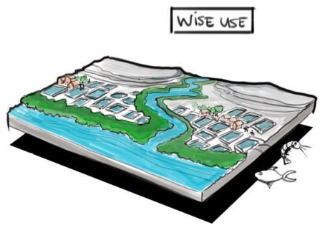


Vision
A prosperous
local economy
enables maintenance of
mangrove greenbelt
Mangrove greenbelt provides
coastal safety
enabling economy to prosper

Slide 33
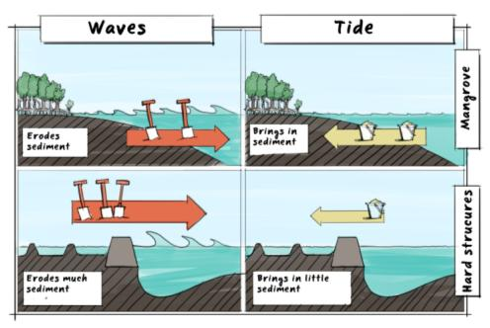
Permeable dams

Slide 34
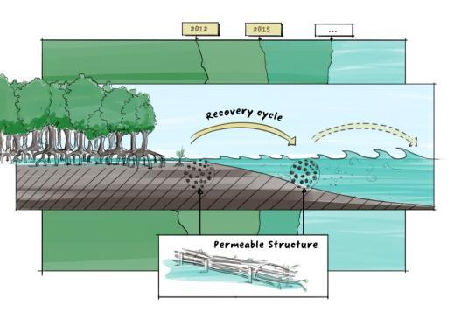
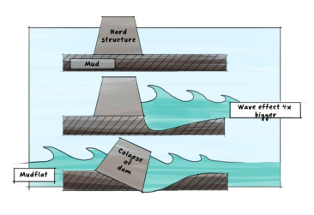
Project – implementatie in project gebied
Erosion hard structures
Mangrove restoration

Slide 35
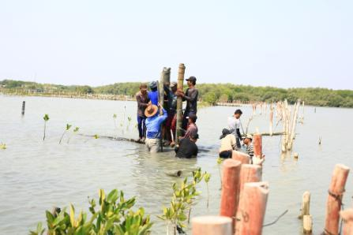
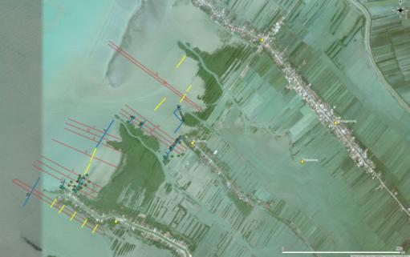
Project – implementation

Slide 36







Cooperation
- Good cooperation with stakeholders is key to succes

Slide 37
Vragen?
Herman.Mondeel@witteveenbos.com

