Slide 1



Notes:
IHE Delft – The world largest post-graduate Institute on Water Education, located in Delft, the Netherlands
Founded in 1957
18,000+ Scientists, Engineers and Decision Makers from 160 countries have been trained
87% of Alumni remain active in the Water Sector
Rotary & IHE Delft together can make a significant and sustainable difference with targeted “Water and Sanitation” and “Water and Peace” scholarship programs
Current Areas of Cooperation
Rotary MSc Scholarship program since 2012
Tri-partite Rotary MSc Water & Peace program since 2015
Central Asia Water Seminars (CAWS) in 2014 & 2016

Slide 2
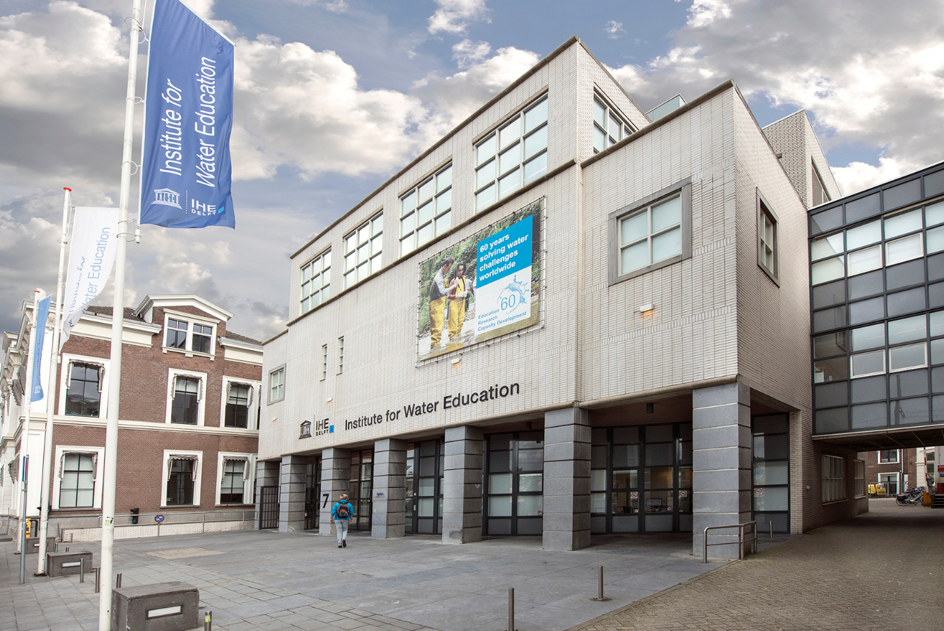

Rotary IHE Delft Scholarships

Slide 3
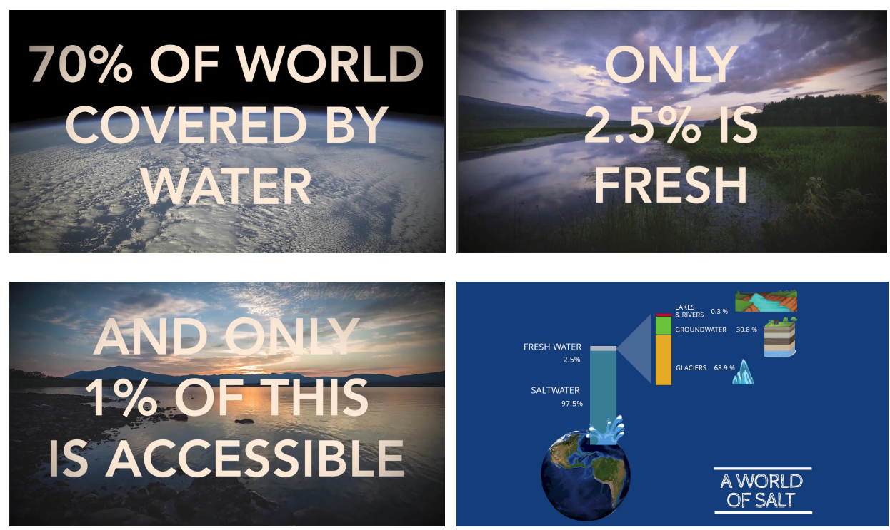

Water
Notes:
IHE Delft – The world largest post-graduate Institute on Water Education, located in Delft, the Netherlands
Founded in 1957
18,000+ Scientists, Engineers and Decision Makers from 160 countries have been trained
87% of Alumni remain active in the Water Sector
Rotary & IHE Delft together can make a significant and sustainable difference with targeted “Water and Sanitation” and “Water and Peace” scholarship programs
Current Areas of Cooperation
Rotary MSc Scholarship program since 2012
Tri-partite Rotary MSc Water & Peace program since 2015
Central Asia Water Seminars (CAWS) in 2014 & 2016

Slide 4

VN: Duurzame Ontwikkelingsdoelstelling 6: WASH
WASH staat voor: water, sanitation and hygiene.
Universele, betaalbare en duurzame toegang tot WASH is een belangrijk probleem voor de volksgezondheid binnen internationale ontwikkeling en is de focus van Duurzame
Ontwikkelingsdoelstelling 6.
Notes:
And also support: 3 – Good Health, 4 – Quality Education and 8 - Economic Growth

Slide 5






Rotary’s Areas of Focus
Peace and conflict prevention/resolution
Disease prevention and treatment
Water and sanitation
Maternal and child health
Basic education and literacy
Economic and community development
Notes:
IHE Delft – The world largest post-graduate Institute on Water Education, located in Delft, the Netherlands
Founded in 1957
18,000+ Scientists, Engineers and Decision Makers from 160 countries have been trained
87% of Alumni remain active in the Water Sector
Rotary & IHE Delft together can make a significant and sustainable difference with targeted “Water and Sanitation” and “Water and Peace” scholarship programs
Current Areas of Cooperation
Rotary MSc Scholarship program since 2012
Tri-partite Rotary MSc Water & Peace program since 2015
Central Asia Water Seminars (CAWS) in 2014 & 2016

Slide 6
Rotary IHE Delft Scholarship Program
Rotary + IHE Delft = tackling global water problems together
Why donate?
• Fund talented students around the world to gain an MSc at IHE Delft in Rotary’s priority areas
• Equip graduates with the knowledge, skills and competencies to tackle local and global water problems
• Facilitate Rotary-sponsored students to engage in local Rotary WASH projects upon returning home
Notes:
IHE Delft – The world largest post-graduate Institute on Water Education, located in Delft, the Netherlands
Founded in 1957
18,000+ Scientists, Engineers and Decision Makers from 160 countries have been trained
87% of Alumni remain active in the Water Sector
Rotary & IHE Delft together can make a significant and sustainable difference with targeted “Water and Sanitation” and “Water and Peace” scholarship programs
Current Areas of Cooperation
Rotary MSc Scholarship program since 2012
Tri-partite Rotary MSc Water & Peace program since 2015
Central Asia Water Seminars (CAWS) in 2014 & 2016

Slide 7
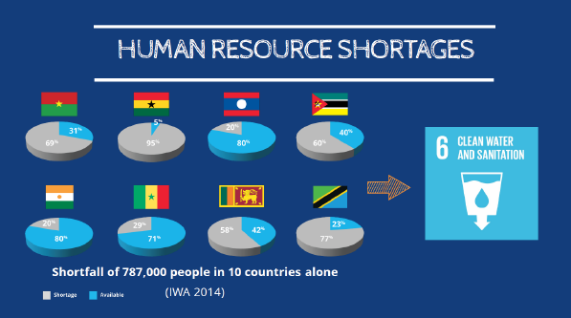
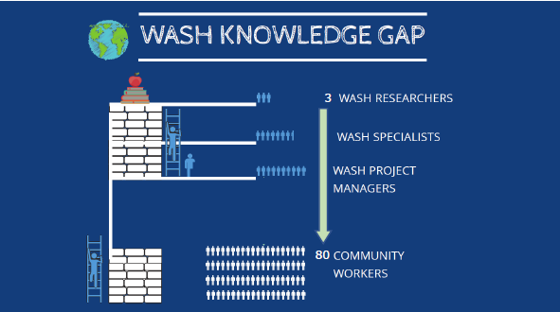
Rotary IHE Delft Scholarship Program
Notes:
IHE Delft – The world largest post-graduate Institute on Water Education, located in Delft, the Netherlands
Founded in 1957
18,000+ Scientists, Engineers and Decision Makers from 160 countries have been trained
87% of Alumni remain active in the Water Sector
Rotary & IHE Delft together can make a significant and sustainable difference with targeted “Water and Sanitation” and “Water and Peace” scholarship programs
Current Areas of Cooperation
Rotary MSc Scholarship program since 2012
Tri-partite Rotary MSc Water & Peace program since 2015
Central Asia Water Seminars (CAWS) in 2014 & 2016

Slide 8

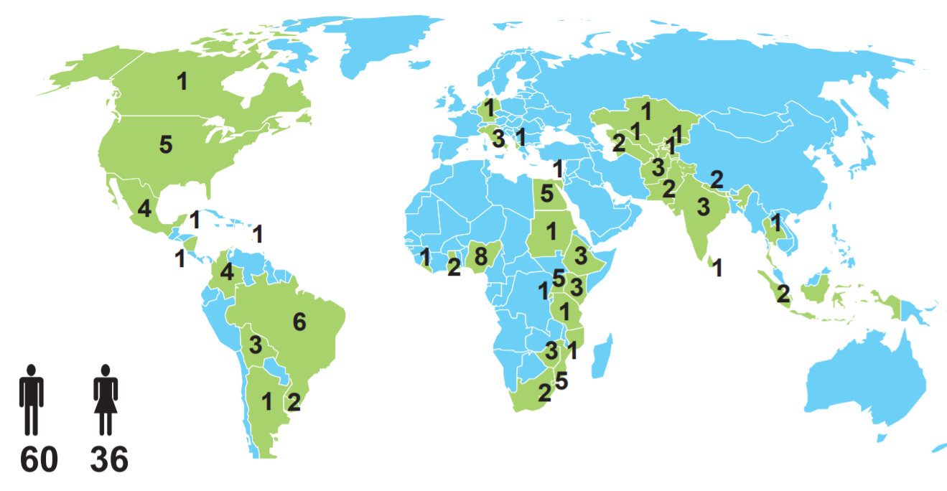
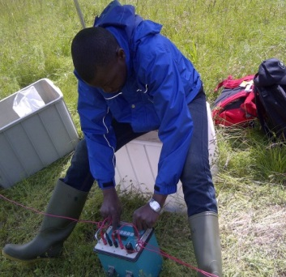
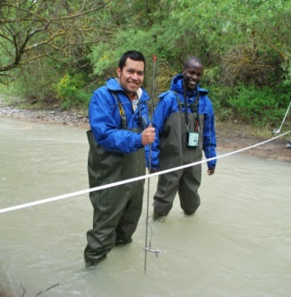
Rotary Water Management MSc Scholarship Programma
Scholarships voor een 18 maanden MSc studie in Water Management en Water Sanitation bij het IHE Delft
96 studenten van 31 landen hebben sinds 2012 een MSc studie
gevolgd in: - Urban Water and Sanitation,
- Water Management and Governance en
- Water Science and Engineering

Slide 9
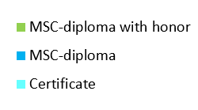
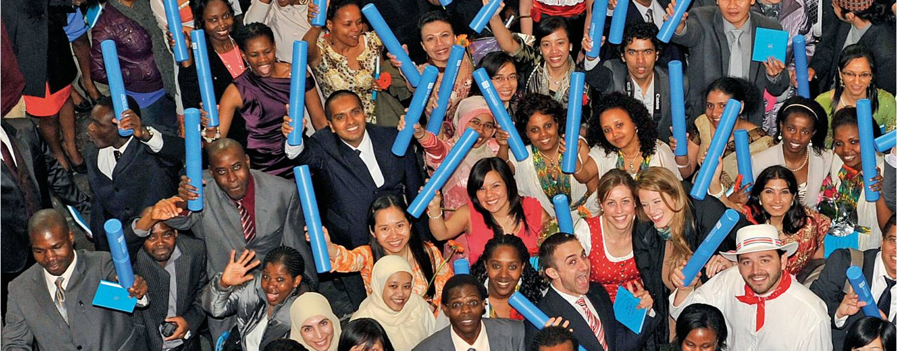
Rotary gaat voor resultaat
12 van de Rotary studenten zijn cum laude afgestudeerd, van de 84 afgestudeerden tot nu toe.
80% van de afgestudeerden werken weer in land van herkomst
  Zij werken in de water sector
  En zijn betrokken bij Rotary water projecten

Slide 10

Financierings voorbeeld
alle bedragen zijn in US $ | Bijdrage | World Fund | TOTAAL
D1600 4 Rotary clubs samen | 12.000 | 6.000 | 18.000
Rotary Club - home country | 1.000 | 500 | 1.500
D1600 DDF | 4.450 | 4.450 | 8.900
DDF District - home country | 3.300 | 3.300 | 6.600
Direct Gift Fonds | 15.000 |  | 15.000
TOTAAL VOOR GLOBAL GRANT |  |  | 50.000
DDF: District Designated Fund
Directed Gift Fonds:
Een klein aantal Rotarians heeft tbv IHE Delft scholarships in totaal $ 450.000,- gedoneerd aan Rotary Foundation International.
Notes:
DDF: District Designated Fund
De clubs dragen ieder jaar bij aan het “Annual Fund” van de Rotary Foundation. 25% van dit bedrag gebruikt het District om als DDF aan Global Grant projecten toe te kennen. De DDF pot voor NL Districten is ongeveer $ 24.000 per jaar.
Directed Gift Fonds:
Een klein aantal Rotarians heeft tbv IHE Delft scholarships in totaal $ 450.000,- gedoneerd via Rotary Foundation International. Uit deze middelen kan $ 15.000 worden toegekend aan ieder van de verwachte 14 Global Grants.

Slide 11
How to contribute?
1) District 1600 IHE Delft project account
Rotary clubs and individual Rotarians can contribute $500-3,000 per year for at least 3-5 years. Cash contributions to the District 1600 IHE Delft project account receive a 50% match from the Rotary Foundation (TRF) World Fund.
2) District Designated Funds (DDF)
Districts can contribute by allocating a percentage of their DDF to the Rotary-IHE Delft Scholarship Program via the Global Grants. DDF contributions to a Global Grant project receive a 100% match from TRF World Fund.
3) Directed Gift Fund
Rotarians can contribute with an individual gift of at least $30,000 via TRF. No World Fund match available. The Directed Gift Fund contributions are used as base funding to ensure long term sustainability of the Rotary-IHE Delft Scholarship Program.
4) Rotary Water Education Endowment Fund
Major gift contributions can be made to the Rotary Water Education Endowment Fund recently established by TRF. Significant investment will be necessary to make this endowment worthwhile. The ambition is to raise $50 million in the next 5 years to support at least 5 MSc scholarships.
Notes:
You could also donate to the ANBI stichting of your own club if there is one.
Other wise SRFN is a good alternative to donate.

Slide 12
Notes:
IHE Delft – The world largest post-graduate Institute on Water Education, located in Delft, the Netherlands
Founded in 1957
18,000+ Scientists, Engineers and Decision Makers from 160 countries have been trained
87% of Alumni remain active in the Water Sector
Rotary & IHE Delft together can make a significant and sustainable difference with targeted “Water and Sanitation” and “Water and Peace” scholarship programs
Current Areas of Cooperation
Rotary MSc Scholarship program since 2012
Tri-partite Rotary MSc Water & Peace program since 2015
Central Asia Water Seminars (CAWS) in 2014 & 2016

Slide 13
BACK UP SLIDES
Notes:
You could also donate to the ANBI stichting of your own club if there is one.
Other wise SRFN is a good alternative to donate.

Slide 14
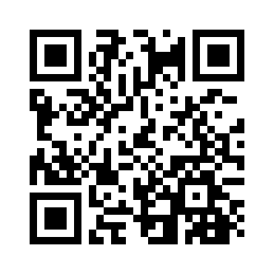

2018 Video on Rotary IHE Delft Partnership
Facebook Page of the Scholarship Program
"Rotary Voices" blog with stories from our students

Slide 15
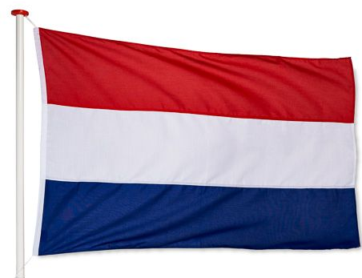
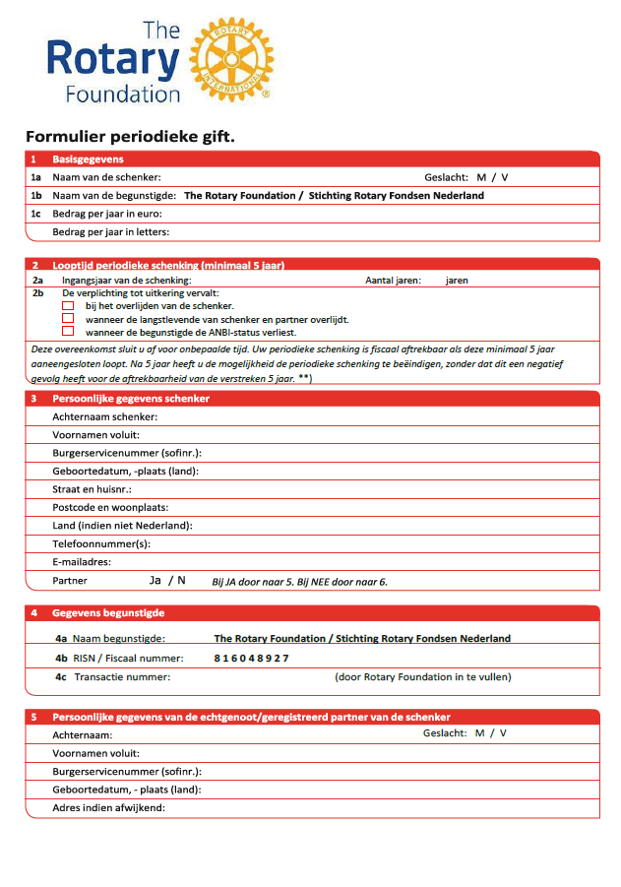
Doneer 5 jaar met belasting aftrek
Doneer voor tenminste 5 jaar een vast bedrag aand “Stichting Rotary Fondsen Nederland”. Deze stichting is erkend door de nederlandse belastingdient als een ANBI stichting.
Uw donatie komt in aanmerking voor belastingsftrek. Voor meer info, kijk op: Belastingdienst-giften en klik op “Ik geef aan een ANBI”
Notes:
You could also donate to the ANBI stichting of your own club if there is one.
Other wise SRFN is a good alternative to donate.

Slide 16
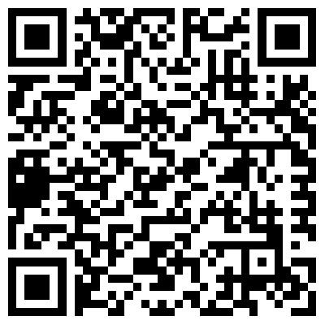
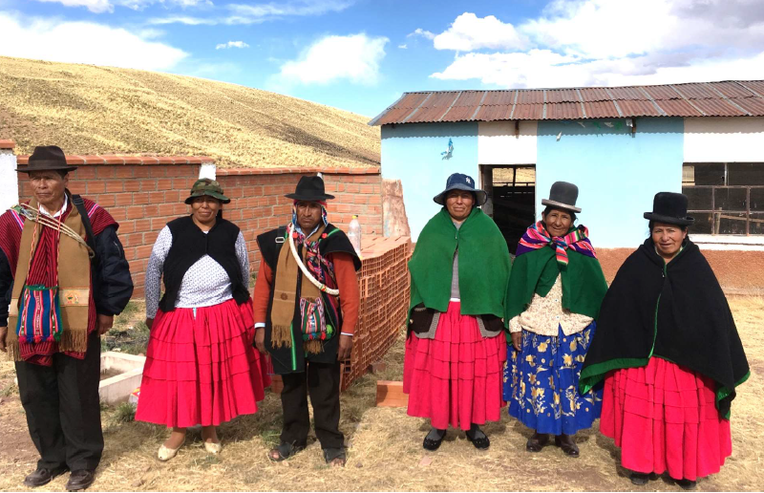
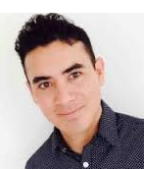
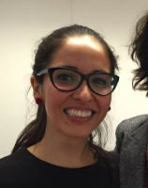
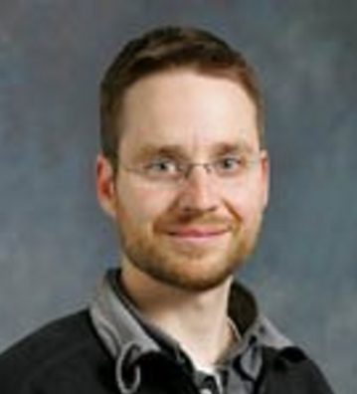
Rotary gaat voor resultaat: Rotary WASH project
  2018 Comanche Eco-sanitation project in West-Bolivia:
  Op initiatief van en uitgevoerd door drie afgestudeerde Rotary IHE Delft Scholars.
  Het doel is om “eco-sanitation” voorzieningen te realiseren in 5 wijken van de gemeente Comanche (~200 families)
  Dit project wordt gefinancierd met Rotary Global Grant (GG1745942).
Project Details
Afnan Agramont
MSc in Water Resources Management
Mariel Ugalde
MSc in Water Services Management
Scott Taggart
MSc in Sanitary Engineering
Notes:
Capacity development through educational workshops
The construction of 175 eco-latrine facilities, including a solar shower device
The formation of community based committees for sustainability

Slide 17
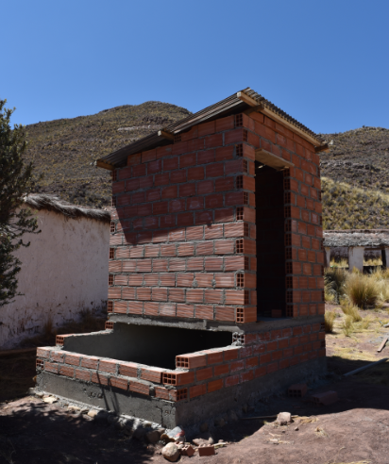
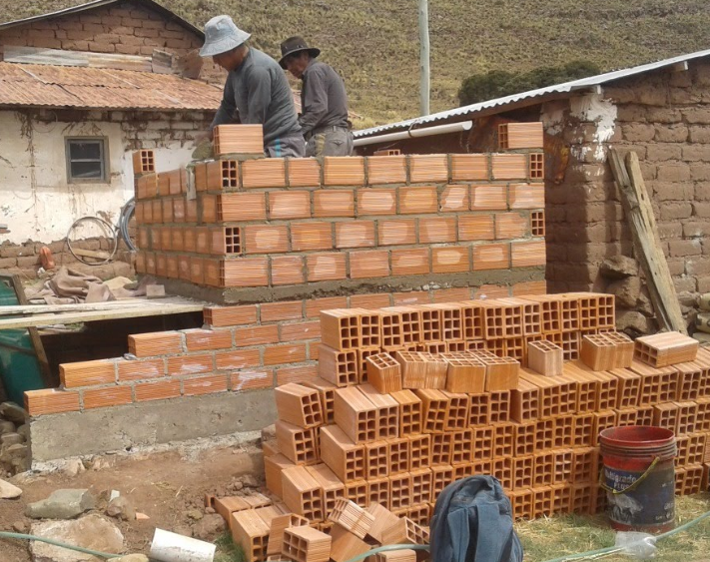
Rotary gaat voor resultaat: Rotary WASH project
Status of Phase 1: construction of 62 latrines as of September 2018

Slide 18
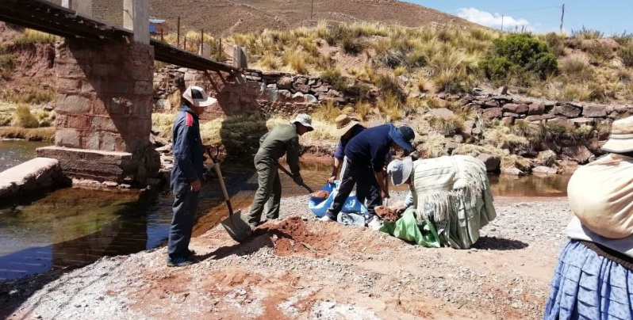
Hoe kan ik hierbij betrokken raken?
Weet U iemand voor wie deze MSc studie in watermanagement nuttig is, neem dan contact op met ons zodat we samen een Global Grant scholarship kunnen ontwikkelen.
Onze afstudeerders die nu in hun eigen land werkzaam, kunnen uw lokale WASH / WASRAG Global Grant projecten met hun expertise ondersteunen.
Wij rekenen op 10 tot 14 studenten per jaar. Daar is minstens $ 500,000 tot $ 700.000 per jaar voor nodig. U, uw club of District kunnen financiële steun
toezeggen. Samen met een World Fund Match van de Rotary Foundation moet $ 700.000,- jaarlijks haalbaar zijn.
Voor meer informatie, e-mail ons via: ihe2019rotary@gmail.com of kijk op deze link.

